Slide 1
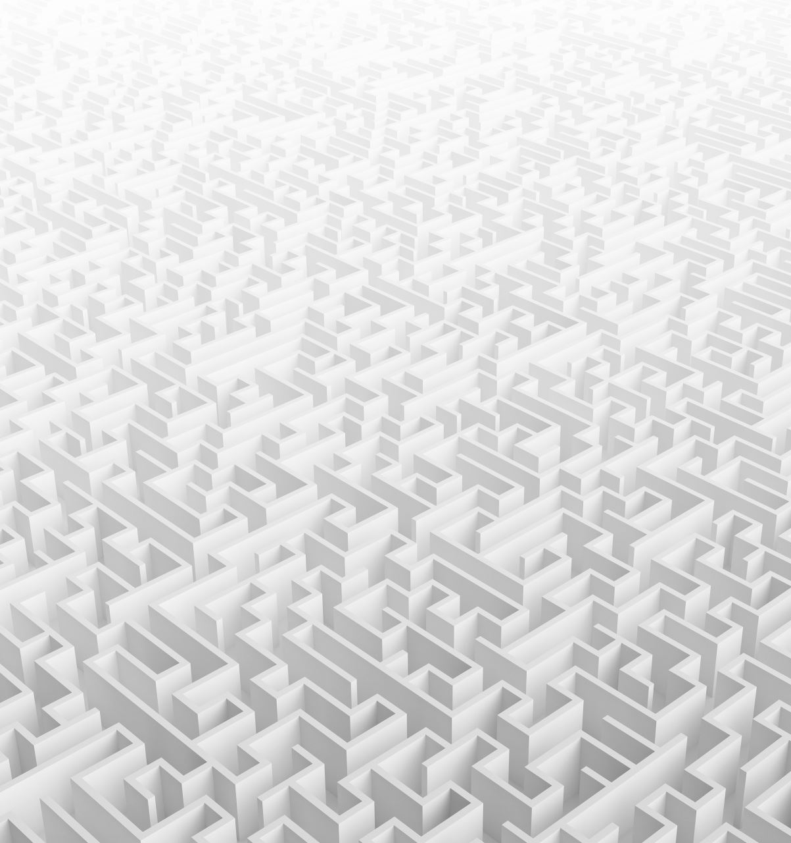
Random Maze Solver

Slide 2
Introduction
Challenge: Found the exit way of a 2D grid maze in less time as possible.
Compare serial and parallel maze solver techniques to move a particle from a starting point to the exit.
Use random walks to move the particle up, down, left, or right but not diagonally

Slide 3
Algorithmic Approach: Serial Implementation
Initialization: Place a particle at the maze's start.
Random Movement: Moves randomly in four directions.
Backtracking: Uses a stack to record the path.
Exit Detection: Continue until the exit is found.

Slide 4
Serial Algorithm Code (Snippet)
void findExit() {
srand(time(0));
Position pos = start;
std::stack<Position> path;
path.push(pos);
while (!isExit(pos)) {
randomMove(pos);
path.push(pos);
}
std::cout << "Exit found at (" << pos.x << ", " << pos.y << ")\n";
std::cout << "Path to exit:\n";
while (!path.empty()) {
Position step = path.top();
path.pop();
std::cout << "(" << step.x << ", " << step.y << ")\n";
}
}

Slide 5
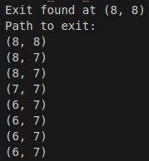
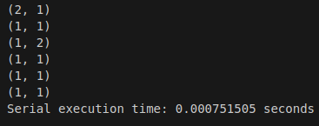
Output
…
int maze [HEIGHT][WIDTH] = {
{1, 1, 1, 1, 1, 1, 1, 1, 1, 1},
{1, 0, 0, 0, 1, 0, 1, 0, 0, 1},
{1, 0, 1, 0, 1, 0, 1, 1, 0, 1},
{1, 0, 1, 0, 0, 0, 0, 0, 0, 1},
{1, 0, 1, 1, 1, 1, 0, 1, 1, 1},
{1, 0, 0, 0, 0, 1, 1, 1, 0, 1},
{1, 0, 1, 1, 0, 0, 1, 1, 0, 1},
{1, 0, 1, 1, 1, 0, 0, 0, 0, 1},
{1, 0, 0, 0, 0, 1, 1, 1, 0, 1},
{1, 1, 1, 1, 1, 1, 1, 1, 1, 1}
};
…

Slide 6
Algorithmic Approach - Parallel Implementation
Parallelism with OpenMP:
Multiple particles move independently.
Each thread represents a particle.
Common flag stops all threads once the exit is found.

Slide 7
Parallel Algorithm Code (Snippet)
void findExitParallel(int numParticles) {
srand(time(0));
bool found = false;
Position finalPos;
#pragma omp parallel num_threads(numParticles)
{
Position pos = start;
while (!found) {
randomMove(pos);
if (isExit(pos)) {
#pragma omp critical if (!found) {
found = true;
finalPos = pos;
}
}
}
}
}
std::cout << "Exit found at (" << finalPos.x << ", " << finalPos.y << ")\n";
}

Slide 8
Performance Evaluation
Results:
Serial Execution Time: 0.000751505 seconds.
Parallel Execution Time: 0.000871662 seconds 1 particle
Parallel Execution Time: 0.0002734 seconds 10 particles
Parallel Execution Time: 0.00027373 seconds 50 particles
Parallel Execution Time: 0.00016527 seconds 100 particles
Conclusion: Multiple searching significantly reduces maze solving time.

Slide 9
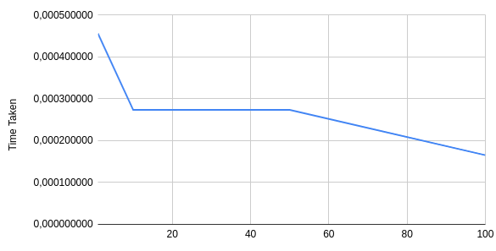
Graph: Thread vs Total time taken

